Slide 1

Case Study 1: Breast Cancer Study
Vincent Mostert

Slide 2


Introduction
This study will use a dataset on Breast Cancer. We will look at different features of the data to predict whether a tumor might be benign or malignant. For this we will use:
Logistic Regression
Feature Selection:
Kbest
Lasso
Kbest + Lasso
Precision Analysis
https://scikit-learn.org/stable/modules/generated/sklearn.datasets.load_breast_cancer.html

Slide 3

Dataset

Slide 4
Information on the Data
Size: The data has 569 entries (rows).
Columns: There are 31 columns in total, with each column having a specific name.
Data Types: The data types of the columns include float64 for most features and category for the 'target' column.
Non-Null Count: All columns have 569 non-null entries, indicating that there are no missing values in any of the columns.
Features: The features include various measurements related to mean values, standard errors, and worst-case scenarios for different aspects related to breast cancer diagnosis. The target variable is binary (0 or 1), indicating the class of the diagnosis (likely indicating malignant or benign).

Slide 5
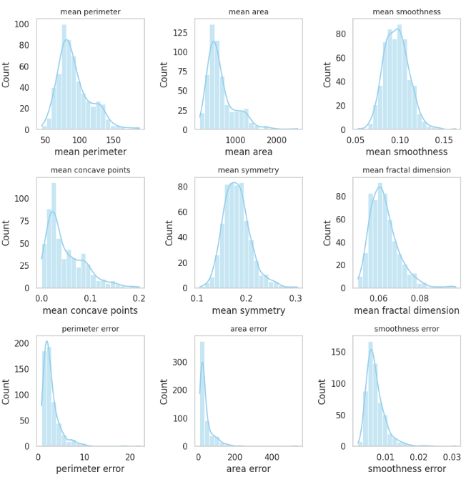
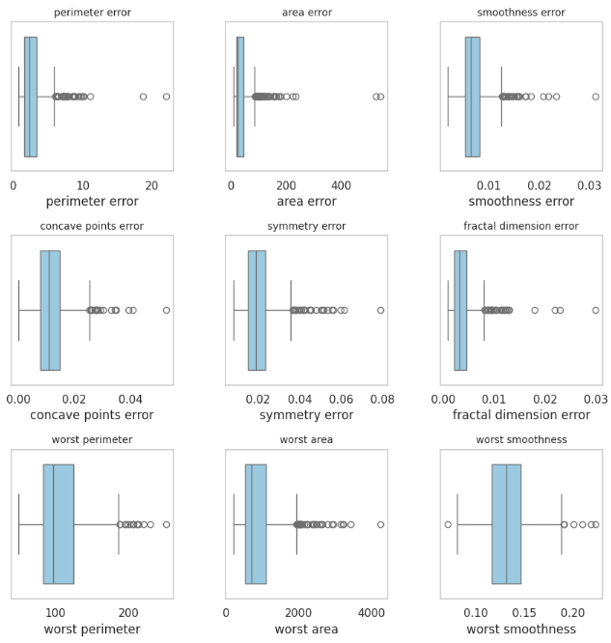
EDA (univariate)
Data normally distributed
Many outliers in the data
Right Skewed

Slide 6
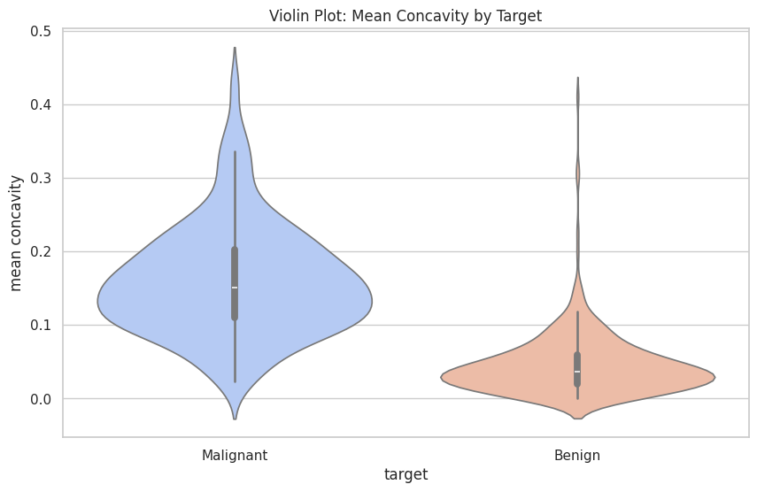
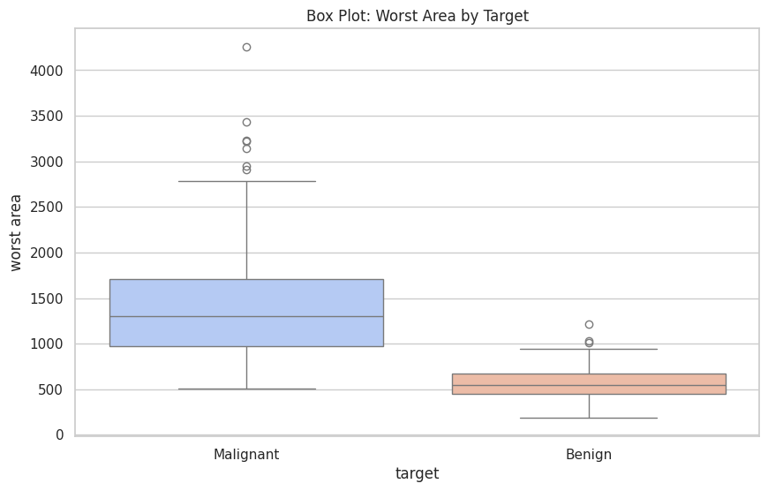
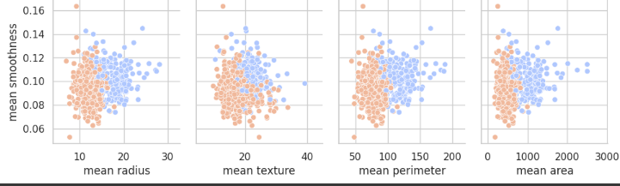

EDA (Bivariate & Multivariate)
Malignant higher mean concavity
Malignant higher worst area.
Clear differences between malignant and benign.
Benign tends to be smaller.

Slide 7

TIMELINE AFTER EDA

Slide 8
Timeline Regressions
Baseline
Base Regression Model using Logistic Regression.
Outliers and scaling
Regression Model with altered dataset (removed outliers and scaled the data).
KBest
Kbest feature selection to select less features for the regression.
Lasso
Kbest + Lasso
Use Lass Regularization algorithm to reduce overfitting.
Combining both feature selection techniques to improve the model even more.

Slide 9
Business Case Objective
2 Main Objectives for this Study:
High Predictability with High Precision: We do not want false negatives. Ergo, a patient should never be told they have a benign tumor if they have a malignant tumor.
Use the least number of features without influencing the precision of the regression analysis.

Slide 10
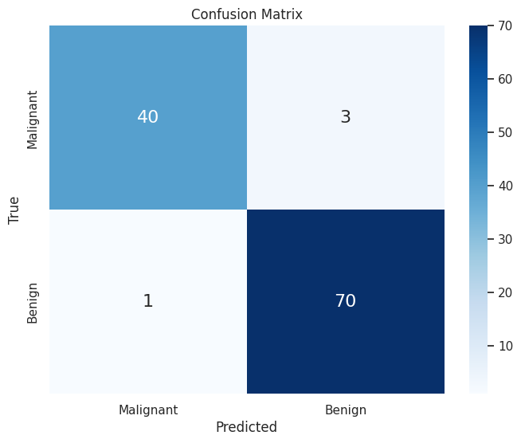
Base Regression
Results
Logistic Regression
Accuracy: 96.33%
Precision: 96.15%
Features used: 30 (all)

Slide 11
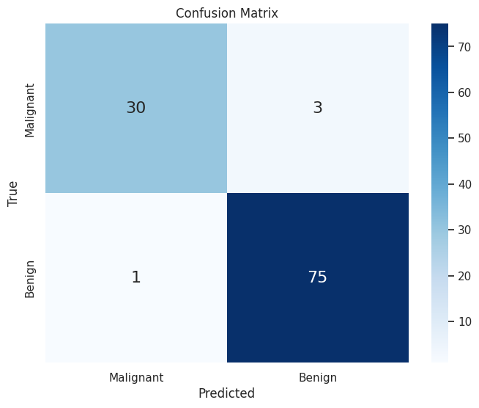
Outlier Treatment
Results
Logistic Regression
Accuracy: 96.49%
Precision: 95.89%
Features used: 30 (all)
→ Better Accuracy but worse precision.

Slide 12
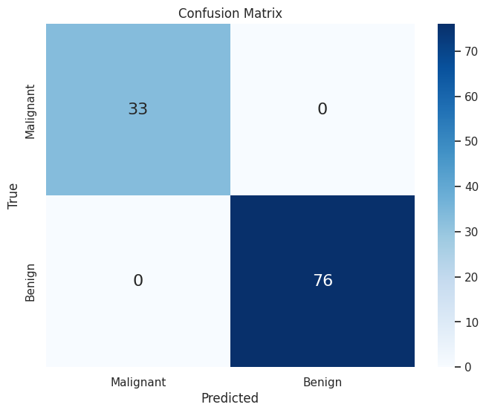
Kbest Feature Selection
Results
Accuracy: 1.0
Precision: 1.0
Features used: 16
→ ‘Perfect’ score but overfit.

Slide 13
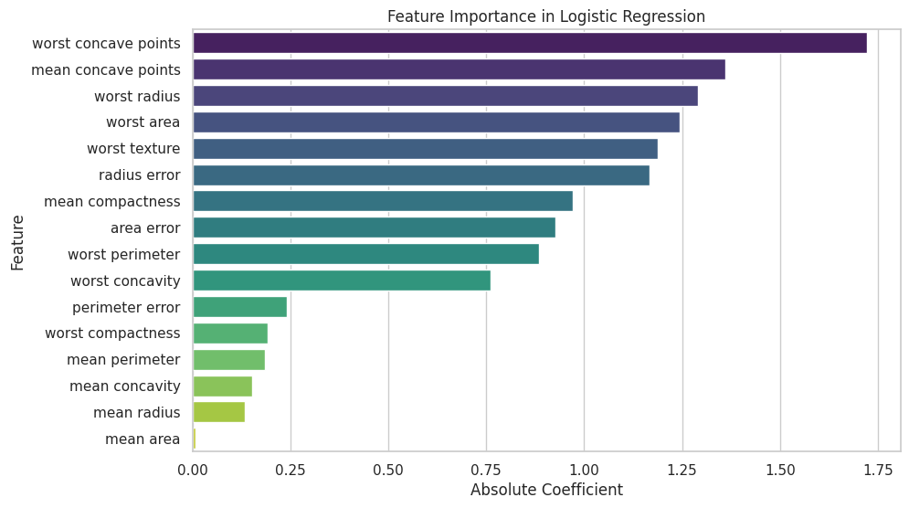
Feature list and influence (Kbest)
10 most important features!
Some almost no importance!
→
Regression Equation: y = 0.1347 * mean radius + 0.1842 * mean texture - 0.0072 * mean perimeter + 0.9717 * mean area + 0.1534 * mean smoothness - 1.3606 * mean compactness - 1.1663 * mean concavity + 0.2403 * mean concave points - 0.9276 * mean symmetry - 1.2895 * mean fractal dimension - 1.1883 * radius error - 0.8846 * texture error - 1.2436 * perimeter error - 0.1929 * area error - 0.7622 * smoothness error - 1.7219 * compactness error

Slide 14
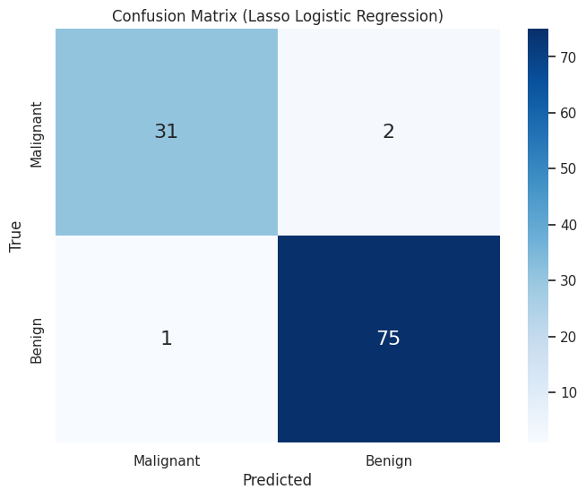
Lasso Regularization
Results
Accuracy: 0.97
Precision: 0.97
Features used: 25
→ Worse than Kbest in terms of performance and features used, but not overfit.

Slide 15
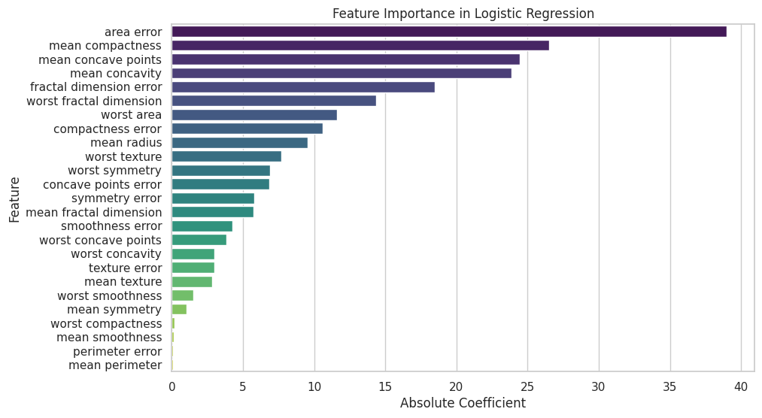
Feature list and influence (Lasso)
10 most important features!
Some almost no importance!
→
Regression Equation: y = 9.573 * mean radius - 2.8118 * mean texture + 0.0842 * mean perimeter + 0.1404 * mean smoothness + 26.5281 * mean compactness - 23.886 * mean concavity - 24.4369 * mean concave points - 1.0218 * mean symmetry - 5.7556 * mean fractal dimension + 2.9963 * texture error - 0.0979 * perimeter error- 39.0148 * area error + 4.2488 * smoothness error + 10.6246 * compactness error - 6.8342 * concave points error + 5.7903 * symmetry error + 18.4869 * fractal dimension error - 7.7 * worst texture - 11.5974 * worst area - 1.5354 * worst smoothness - 0.2015 * worst compactness - 3.0122 * worst concavity - 3.8314 * worst concave points - 6.8818 * worst symmetry - 14.3669 * worst fractal dimension

Slide 16

Kbest + Lasso Regularization
Results
Accuracy: 0.99
Precision: 1.0
Features used: 7
→ Perfect for business case and only 7 features used!

Slide 17
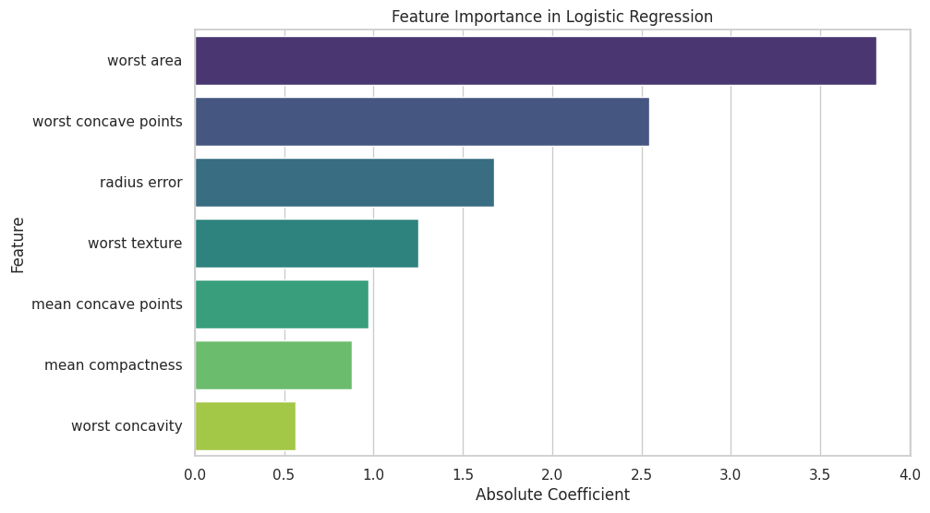
Feature list and influence (Kbest+Lasso)
Regression Equation: y = 0.8775 * mean compactness - 0.9717 * mean concave points - 1.6773 * radius error - 1.2520 * worst texture - 3.8138 * worst area - 0.5669 * worst concavity - 2.5425 * worst concave points

Slide 18



Summary
The best model was the model where we combined Kbest with Lasso.
We got a perfect precision score.
We minimized overfitting, meaning it will perform rather well with foreign data.
Lasso is a great tool to improve a regression model and minimize overfitting but is not always best alone. In this scenario it was better to combine it with Kbest.
The 3 techniques different in top 10 features.

Slide 19


THANK YOU
Vincent Mostert

